Slide 1
Establishing a Bicycle-based Bakery in Portland
Coursera Capstone Final Assignment by Dustin Knudsen

Slide 2
Introduction
Portland is home to many bicycle lovers
The city itself is home to many routes, bicycle lanes, and bicycle shops
By 2030, the city hopes to have over a quarter of all trips made by bike
It’s also home to many health-conscious individuals who can be selective about what they eat.
Menus at restaurants and other food and drink venues often cater to the healthy eating lifestyles of Portland’s inhabitants.

Slide 3
Problem
Anne wants to start a gluten-free, lactose-free, organic bakery in Portland that uses a bicycle delivery system as part of its workforce
Nearly 3,000 bicycle thefts are reported each year to the police, and this doesn’t include the larger number of unreported thefts.
Anne wants her business in a neighborhood with low crime, close proximity to a bike shop, and fewer competitors

Slide 4
Data
https://www.portlandoregon.gov/police/71978 - Portland Police Bureau 2018 Crime Data (CSV)
https://gis-pdx.opendata.arcgis.com/datasets -PortlandMaps - Open Data for Neighborhoods and Bicycle Data Points (CSV, GeoJSON)

Slide 5
Methodology
Libraries
NumPy - Handles Data in a Vectorized Manner
Pandas - Library for Data Analysis
Requests - Handles requests to API
Json - Handles JSON files
Geocoders - Uses Nominatim to convert address into latitude and longitude
Folium - Map Rendering Library

Slide 6
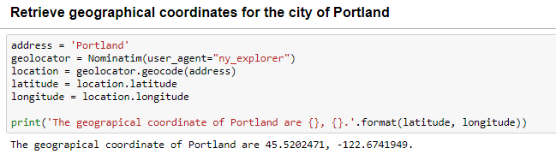
Methodology (cont’d)
First used the Nominatim method, which is part of the Geocoder library to retrieve coordinates for the city of Portland

Slide 7
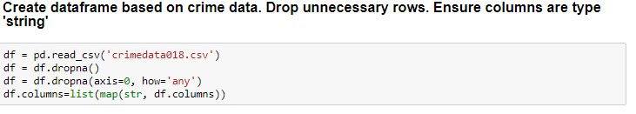
Methodology (cont’d)
Then created a dataframe based on the crime data. Afterwards, dropping unnecessary rows and making sure the columns were of type ‘string.’

Slide 8
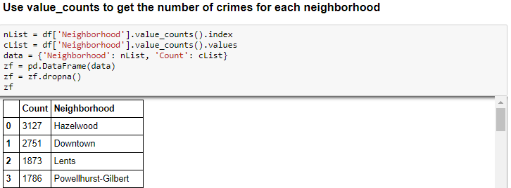
Methodology (cont’d)
Created a separate data frame which showed how many crimes were in each neighborhood

Slide 9
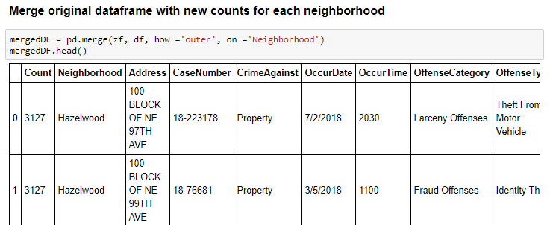
Methodology (cont’d)
Merged the new data frame with original data to create crime-count relationship

Slide 10
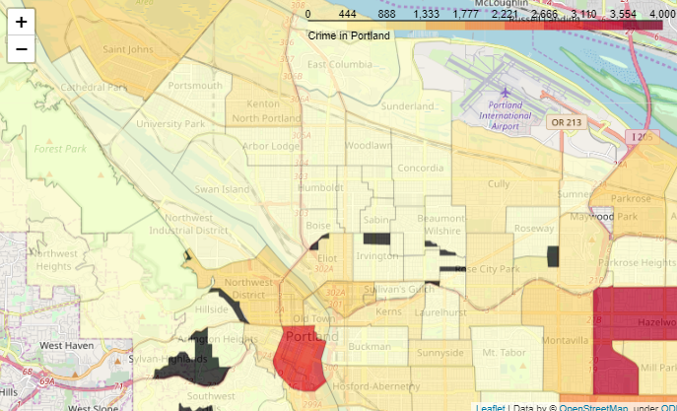
Methodology (cont’d)
Create a choropleth map based on the amount of crime exists in each Portland neighborhood

Slide 11
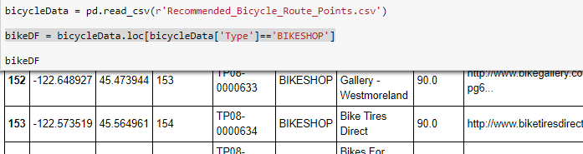
Methodology (cont’d)
Acquired bike shop data from the csv file and made a data frame with it

Slide 12
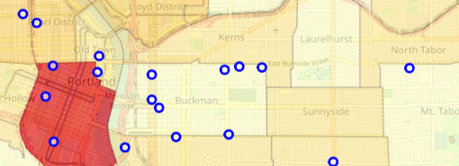
Methodology (cont’d)
Superimpose bike shop data points on to choropleth map to show where each bike shop is in relationship to the neighborhoods and their respective crime levels

Slide 13
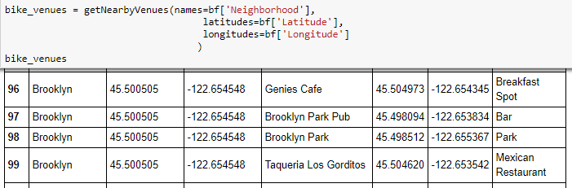
Methodology (cont’d)
Use Foursquare API to generate data frame of venues near each bike shop

Slide 14
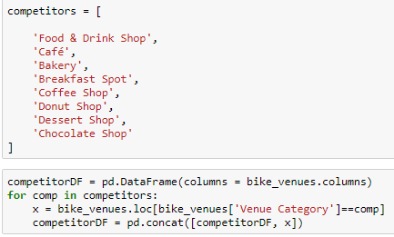
Methodology (cont’d)
Create a list of conditions to suggest which shops are competitors and make a dataframe out of that information

Slide 15
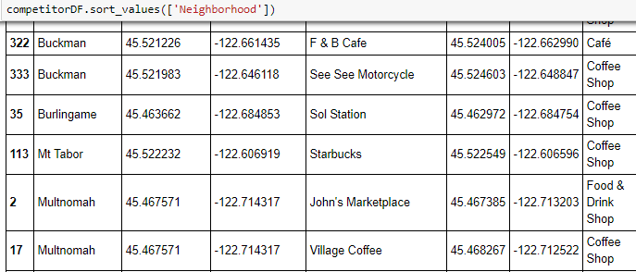
Methodology (cont’d)
Using this information, Anne can decide which neighborhood is best to start her business!

Slide 16
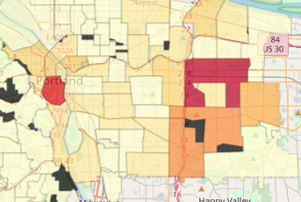
Results
East Portland has more crime than the rest of Portland
Downtown is especially heavy in crime

Slide 17
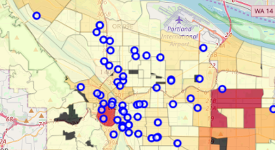
Results (cont’d)
West Portland had very few bike shops
Shops clustered around downtown and also up I-5 freeway

Slide 18
Discussion
Gresham lies east of Portland. It’s known for high crime.
Downtown has the highest concentration of bicycle shops
Bicycle theft may be higher in downtown areas
West Portland may have lower population and/or higher income suburbanites
Shops along I-5 may indicate a main bike travel artery

Slide 19
Conclusion
Anne chose Mount Tabor to build her business due to less crime, proximity to a bike shop, and fewer competitors.
Buckman had a large number of bike shops, but also many competitors
Downtown may still be more suitable for her business due to bicycling accomodations
Population density in residential vs business should be considered

